Slide 1

BIG DATA and ANALYTICS CAPABILITIES

Slide 2














Business intelligence credentials
Enterprise Performance Management
BI maturity analysis
Balanced scorecard development
KPI development and linking
Balanced scorecard implementation
KPI driven OGSM dashboard development
BI and analytics
Reporting portals
BI workflows
Ad-hoc reporting provisioning
Reporting and Analytics development
Canned and ad-hoc reports and analytics
Enterprise data strategy
DW migration and modernization
ETL and validation
Monitoring and global support
DW and MDM development
Platform integration, migration and modernization
Data Integration, Cleansing, De-duplication, Matching, MDM
Big Data Analytics
Data integration, cleansing
360 degree view of customer
Server data monitoring
Leading Travel Company
Data Hub and Analytics
Stream integration, data platform, analytics
Data Integration, Cleansing, De-duplication, Matching, MDM
[24/7]

Slide 3
UI Look and Feel
Integrated Security
Data Alerts
Speed and Flexibility in development
End User Reporting Options
Leverage SharePoint features like workflow
One Portal

Slide 4

BIG DATA Technology capabilities
Visualization and Analytics
100+ BI consultants with MS and Oracle BI skills
10+ Big Data consultants with expertise in
HortonWorks Hadoop
Hive/Pig .MapReduce
Tableau, QlikView
Tableau
QlikView
Microsoft Excel
Processing and Analysis
HDInsight
Cloudera
HortonWorks
StreamInsight
Azure SQL
MySQL
Storage
mongoDB
Cassandra
Amazon S3
ETL
Microsoft SSIS
Oracle OBIE, ODI
Talend
Data Integration, Cleansing, De-duplication, Matching, MDM
Data Input
Social Analytics Clickstream Excel ERP Enterprise DW CMS …….. salesforce

Slide 5





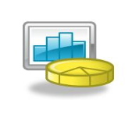

Big data Solutions we offer
Structured Data
Enhanced 360º View of the Customer
Multi-channel customer experience analysis
Enterprise
Applications
Clickstream Data
Websites
Operations Analysis
Analyzing operational data from RFID, GPS devices, and sensors .
Real-time Data
Analytics
Mobile and Sensor Devices
Exploratory Analysis
Identifying new patterns by correlating internal data with external data sources such as weather, traffic, population, etc.
Streaming Data
Weather, Financial Data
Security and Intelligence Extension
Fraud and surveillance capabilities, cyber security
Unstructured Data
Social Networking sites

Slide 6











Microsoft platform capabilities
Comprehensive Capability Across Cloud, Data And Mobile Platforms With Leadership On Microsoft Technologies
Devices
Apps
Data
StreamInsight
DQS
Windows Phone
Platform
Infra
PARTNER OF THE YEAR
US - West
Winner
MICROSOFT
TECHNOLOGY
CENTER
1 of 4
Global
Service partner

Slide 7
What we have learnt – Our Approach
Build the Foundation
Data Quality analysis, Data Cleansing, Standardization, Enrichment, and Master Data Management
Integrate Data
Integration of multiple data sources including on-premises and cloud, to bring together structured and unstructured data
Enable Visualization
Contextualized Insights, role-based dashboards and scorecards
Improve Reach
Instant access to decision making anywhere on mobiles and smart devices with self-service capabilities
Achieve Scale
Big Data Solutions by leveraging cloud

Slide 8






Data Platform
Fragmented view of information across disparate sources
Variable, heterogeneous data from multiple data sources
Poor data quality affecting quality of BI
Lack of consistent definition of data
CHALLENGE
Data Quality Needs Analysis
Cleansing, Standardization, and enrichment of data
Enterprise-wide master data management
Data Stewardship Programs
ETL Solutions and Data Warehouses
Real time, CDC, Cloud, and unstructured data integration
Solution
Brings greater confidence in your analytic systems
Achieve a single version of the truth by combining data from multiple data sources
Improve effectiveness of downstream BI operations
Benefits

Slide 9
Case Study – Ladbrokes
Client:
One of the world‘s leading betting and gaming websites with over 600,000 active customers betting in more than 17 languages and 12 currencies.
Needs
Challenges
Solution
Ability to analyze extremely large volumes of data generated everyday to identify trends and analyze customer behavior in real time
Build a strong Data Warehouse foundation that can extract data from multiple sources
Data quality and availability
Real time reporting and self-service business intelligence
Huge data volumes coming from a variety of data sources such as kiosk, web and store
Data from multiple countries in different formats and languages
Poor quality of data extended data profiling
Constantly changing source schema – over 5 times in 2 years
Data extraction from multiple sources including flat files and CSVs
Multiple non-standard schemas and currency
Aggregation of data leveraging Big Data technologies and ETL platforms like ODI
Data migration from conventional DW
Visualisation and score-carding
Real time complex event processing
Business Benefits
Analyze product profitability trends
Support for end-to-end BI roadmap from data governance to production support
Improved data quality for actionable insight
100 M
records per day
15 TB
Data volume
30 mins
Data load
30 +
Data Sources
300 +
Power users

Slide 10







Visualization/Analytics
Ability to analyze complex scenarios
Lack of Context to reports and dashboards
Lack of top down data visibility from strategic to operational
Trend Analysis from real-time streaming data
CHALLENGE
Contextual BI with Reports, Scorecards, and Dashboards
Product BI to enhance existing ISV products
Framework driven approach with ETLEasy, a ETL framework for ISVs
High Speed Processing of Events with real-time data for use Cases such as Trend Analysis, etc
Solution
Enable end-to-end visibility from executives to operational staff
Increase Market Reach by enhancing existing ISV products with BI features
Enable real-time decision making with high speed data processing
Benefits

Slide 11
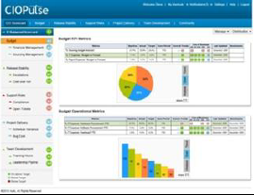
CIO DASHBOARD provides greater VISIBILITY INTO IT EXPENDITURE
BUSINESS CONTEXT
USER CONTEXT
CHALLENGES
ENGAGEMENT
For managing a $1.4 billion IT Budget and making critical budget decisions, MetLife’s CIO needed visibility into IT Expenditure using BI capabilities and the ability to collaborate with others around the data.
Business Users on the CIO’s team were not comfortable using the existing reporting system, since it could not provide a single view of their IT expenditure.
MetLife CIO and the IT team were experiencing challenges in managing IT portfolio, budgets, projects and tracking their vendors, since the data was spread across multiple business systems.
MetLife wanted to migrate from their existing reporting system to an enterprise-wide collaborative BI operational tool. The tool was expected to offer collaborative features such as expert search, profiling, etc.
CONSOLIDATED VIEW OF IT SPEND helps detect issues faster and optimize operations
SOLUTION HIGHLIGHTS
1. Aditi partnered with MetLife to build a collaboration portal to host BI reports and dashboards.
2. The BI solution combined data from more than 30 systems such as ERP, HRMS, Actuate, and point solutions.
SOLUTION SHOWCASE
3. The CIO of this 2400 strong IT was able to comprehend IT spending and could better justify departmental budgets.
4. With click-through analysis and collaboration features, MetLife could now act on root causes early and share.

Slide 12
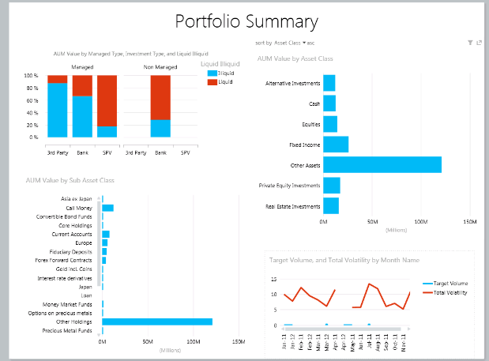
integrated team portal with analytics improves client service
BUSINESS CONTEXT
USER CONTEXT
CHALLENGES
ENGAGEMENT
The Family Office, a leading provider of investment advisory services was facing reporting, information management, and collaboration challenges due to over reliance on Excel for storing the entire customer financial data.
TFO analysts and portfolio managers was challenged with managing the spreadsheet resident data and analyze market and customer data, fund performance, asset allocation, and research content on-demand.
TFO needed a solution using familiar tools that could help with automation and organization of the research process. The solution was expected to support all investment management needs of the advisory team.
Aditi team engaged in data integration and deployment of PowerPivot, PowerView with Excel for the investment management and reporting needs of family offices.
Consolidated view of financial information with workflows and collaboration
SOLUTION HIGHLIGHTS
1. The solution developed using Microsoft SharePoint, SQL Server served as an integrated team portal.
2. The end users had the flexibility to choose reporting tools such as Excel, PowerPivot, PowerView, SSRS.
SOLUTION SHOWCASE
3. Improved client servicing through personalized, real time, comprehensive reporting.
4. Improved productivity through integrated workflows with trade management, accounting, analytics capabilities.

Slide 13
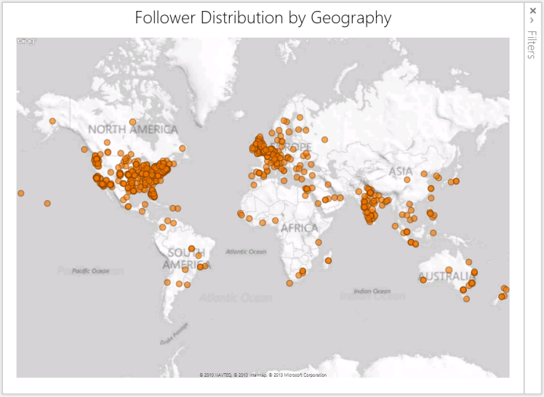
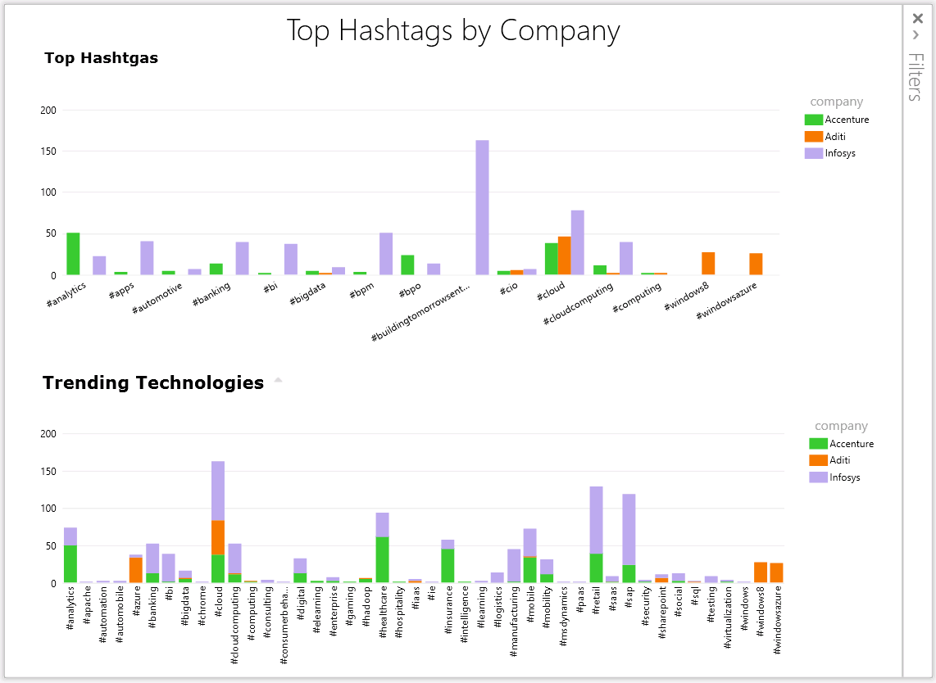
Case Study – COMPLEX EVENT PROCESSING
Challenges
Solutions
Powered by:
HBase (HDFS)
HDInsight
HIVE / PIG
SQOOP
Microsoft BI
SSAS
SSRS
SSIS
StreamInsight
PowerPivot
Twitter feeds are a rich source of information about sentiments, trending topics, and other statistics in the form of URL, emotions, blogs, photos, etc.
Using Microsoft big data solution to analyze millions of tweets
Comparative Twitter analysis of multiple twitter handles using #hashtags, @mentions, @users, and keywords, users
Data analysis and rich visualization for presenting twitter data with key metrics such as tweet velocity, top hashtags, popular retweets posts, and sentiment analysis

Slide 14
Case Study – [24]7 Customer
Client:
[24]7 is global online technology and operations company managing over 2.5 Billion interactions through its 9 global contact centers and has transformed over 20 million of these interactions into predictive experiences
Needs
Solution
Business Benefits
Advanced Analytics: Self-service reporting on customer interaction history
Big Data: Aggregate data from multiple channels like CRM, social networks, location and products, and multiple data formats including voice and log files
Real time decision making
Co-engineering partner: Partner with proven capabilities to work along-side customer’s development teams
Open source Big data solution (Hive/Pig) to process massive amounts of structured and unstructured data
SQL Server 2012 Data Warehouse for collection and storage of unlimited data
OLAP solution on SQL Server to mine data and devise customer interaction strategies
Technologies Used
SQL Server 2012
Cassandra
MySQL and Custom MySQL
Apache Kafka (Messaging)
Hive/ Pig
SSAS (for multi-dimension cube), SSRS (Reports)
Cutting-edge analytics enabled products: By leveraging customer interaction history across all channels with analytics and big data capabilities, the client could deliver an innovative product suite for their customers
Opportunity to drive Business Growth: With the improved product suite, the client could serve their clients better by understanding their customer’s intent and personalize the customer experience across channels
10 TB
of data
Voice and call
learning
Hadoop
data processing
10
data sources

Slide 15
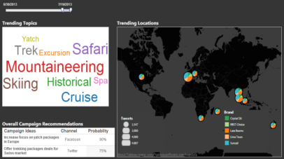
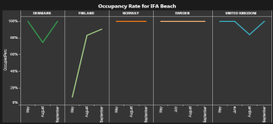
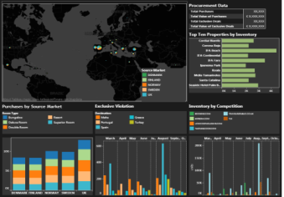
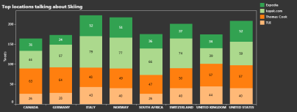
Leading Travel Company Achieves Efficient Sourcing with Big DATA
BUSINESS
SOLUTION
BUSINESS BENEFITS
Company wanted to provide unified access, analysis, and visualisation of web analytics, costs, booking and hotel contracting data from a subset of company’s approximately 30 mainstream businesses (Mainstream Joint Purchasing).
ADITI implemented a Big Data and Analytics solution by leveraging:
Aggregated relational and non relational sources in Hadoop as a store all cluster
Optimized columnar data warehouse leveraging
State of the art ELT leveraging open source tools like Talend
Comprehensive omni-channel visualizations using Tableau
Having a unified view meant, source markets and corporate have:
Better predictability of prices
Reduced procurement costs
Higher fill rates for rooms
Increased time to value
Group level roll up of procurement, fill rate performance
Dimension modelling across brands, markets and groups to reflect top down performance
Aligning sourcing to customer demands
CLOUD, BIG DATA and Open source Technologies translated business Need to reality in 6 weeks
SOLUTION HIGHLIGHTS
1. Structured/unstructured data aggregation for a 360 degree view of the customer
2. Improved sourcing of inventory at better prices
SOLUTION SHOWCASE
3. Real time sentiment analysis leveraging social feeds from more than 11 to 12 diverse sources

Slide 16
















CUSTOMERS TRUST US WITH THEIR DATA PROBLEMS

Slide 17
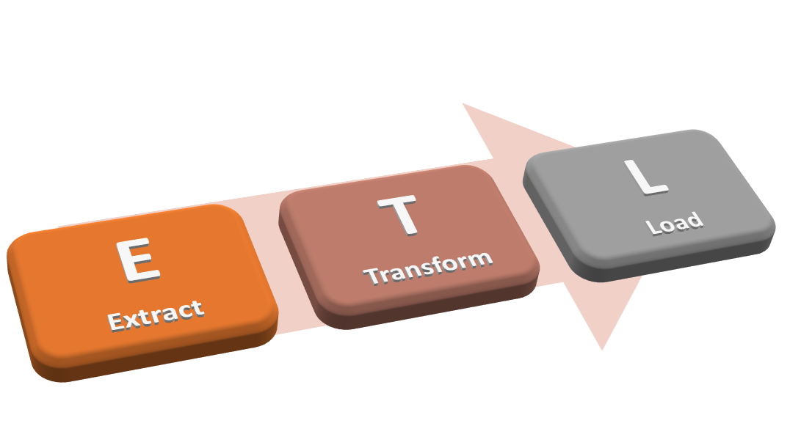

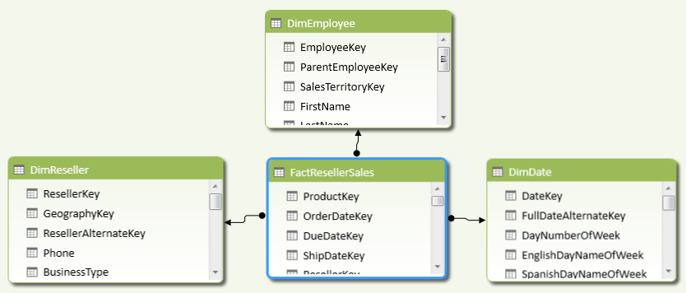
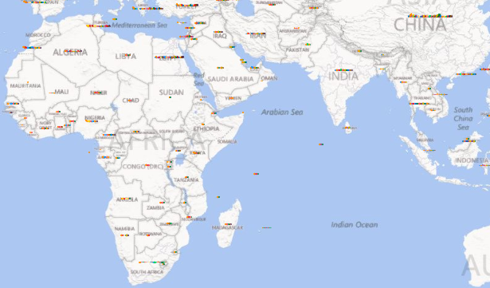
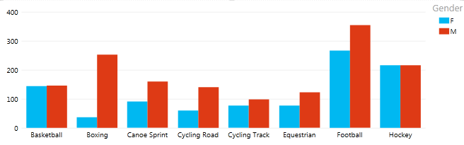
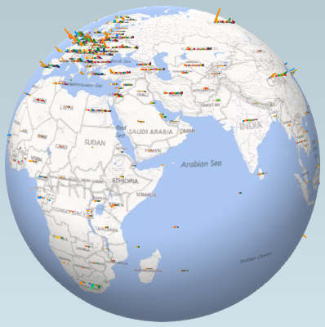
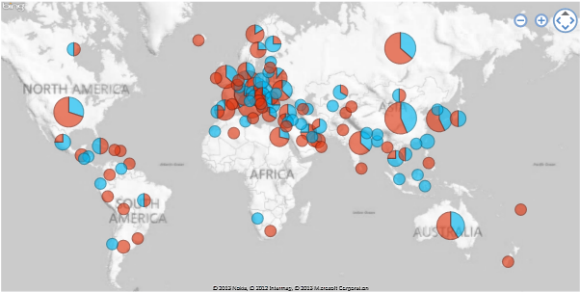
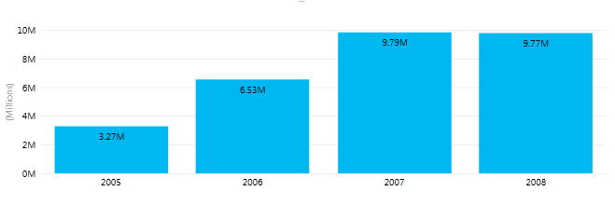
Power BI
Power BI
Power Query
Power Pivot
Power Maps
Power View
Power BI
(Excel)
Notes:
Excel 2010
Only Power Query & Power Pivot
Excel 2013
Power Pivot & Power View are pre-installed – Need to enable
Power Query & Power Maps – Need to install
In-memory Technologies

Slide 18



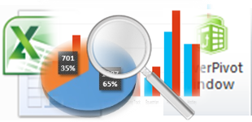

Power BI – Feature Mapping
Discover
Collaborate
Consolidate
Model
Analyze
Visualize
Share
Power Query
Power Query / Power Pivot
Power Pivot
Excel
Excel Pivots / Power View / Power Maps
SharePoint
SharePoint

Slide 19
Demo Self SERVICE BI

Slide 20
Why SHAREPOINT 2013 For BI
One Portal
Uniform look and feel
Leverage SharePoint features like workflow
Integrated security
Data Alerts
Speed and Flexibility in development
End User Reporting Options
Power View
Excel Services
Report builder

Slide 21
Web | Blog | Facebook | Twitter | LinkedIn

Slide 22
KEY ADDITIONAL Information

Slide 23
Data visualization products
 | QlikView | Tableau | MS BI
Implementation time | Short | Short | Average
Scalability | Depends on RAM | Good | Excellent
Overall Cost | High | Above Average | Average
Dashboard support | Excellent | Excellent | Average
Visual drilldown | Excellent | Excellent | Good
Mobile Support | Good | Good | Average
Integration | Average | Average | Excellent

